Slide 1
Graphs
EQ: How do I determine which type of graph is the best one to display a dataset?

Slide 2
Learning Outcomes
Dot Points
1.4.3 discuss and interpret graphs found in the media and in factual texts
Contexts
Determine whether the information displayed in a graph is a true representation of the data

Slide 3
Opening Problem- Class Discussion:
When they’re used well, graphs can help us understand data. But as visual software has enabled more usage of graphs throughout all media, it has also made them easier to use in a careless or dishonest way.
https://www.youtube.com/watch?v=E91bGT9BjYk

Slide 4
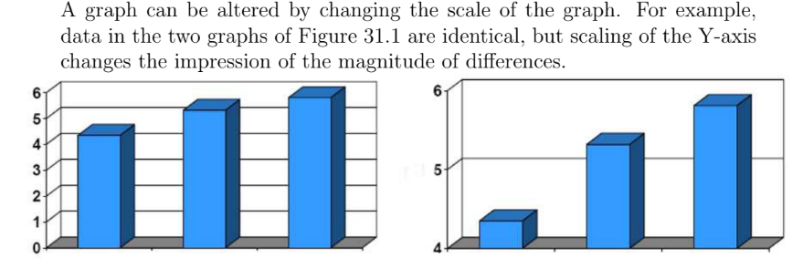

Slide 5
24
7
30
Topic: Graphs
Date
EQ: How do I determine which type of graph is the best one to display a dataset?
Ways to Make a Graph Misleading
Vertical scale is too big or too small
Vertical axis skips numbers, or does not start at zero
Graph is not labeled properly.
Graph does not have a Title to explain what it is about.
Scale not starting at zero
Scale made in very small units to make graph look very big.
Scale values or labels missing from the graph.
Oversized volumes of objects that are too big for the vertical scale differences they represent.
Size of images used in picture graphs being different for the different categories being graphed
Graph being a non-standard size or shape.

Slide 6
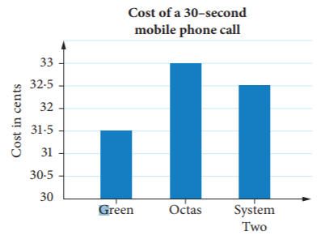
Examples For each of these graphs answer the following three questions: (a) What is the main message that the graph is trying to tell you? (b) What is bad or misleading about the graph? (c) How could you improve it?
Notes:
30 sec phone call graph:
Only showing a small part of the vertical axis makes it appear Octas is by far the better option. On closer inspection the difference is not that great. Gives a misleading impression.
Presidential race graph:
- Oversized volumes of objects that are too big for the scale ( Obama vs McCain. Also Clinton vs Huckabee) . They are not the same yet the bars are equal)

Slide 7
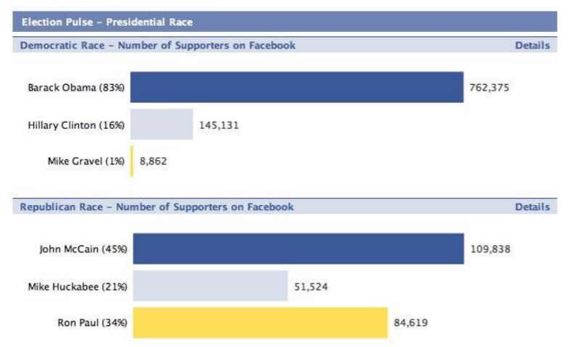
Examples For each of these eight graphs answer the following three questions: (a) What is the main message that the graph is trying to tell you? (b) What is bad or misleading about the graph? (c) How could you improve it?
Notes:
30 sec phone call graph:
Only showing a small part of the vertical axis makes it appear Octas is by far the better option. On closer inspection the difference is not that great. Gives a misleading impression.
Presidential race graph:
- Oversized volumes of objects that are too big for the scale ( Obama vs McCain. Also Clinton vs Huckabee) . They are not the same yet the bars are equal)

Slide 8
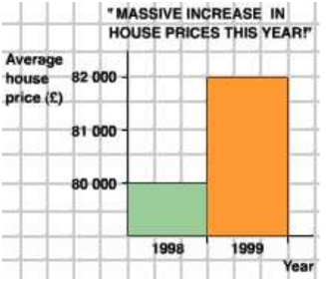
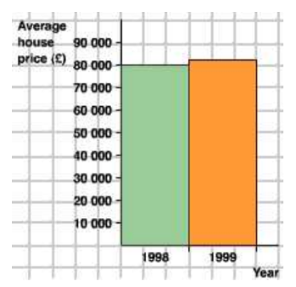
Examples For each of these eight graphs answer the following three questions: (a) What is the main message that the graph is trying to tell you? (b) What is bad or misleading about the graph? (c) How could you improve it?
Notes:
30 sec phone call graph:
Only showing a small part of the vertical axis makes it appear Octas is by far the better option. On closer inspection the difference is not that great. Gives a misleading impression.
Presidential race graph:
- Oversized volumes of objects that are too big for the scale ( Obama vs McCain. Also Clinton vs Huckabee) . They are not the same yet the bars are equal)

Slide 9
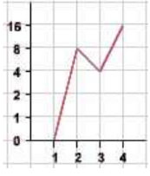
Examples For each of these eight graphs answer the following three questions: (a) What is the main message that the graph is trying to tell you? (b) What is bad or misleading about the graph? (c) How could you improve it?
Notes:
30 sec phone call graph:
Only showing a small part of the vertical axis makes it appear Octas is by far the better option. On closer inspection the difference is not that great. Gives a misleading impression.
Presidential race graph:
- Oversized volumes of objects that are too big for the scale ( Obama vs McCain. Also Clinton vs Huckabee) . They are not the same yet the bars are equal)

Slide 10
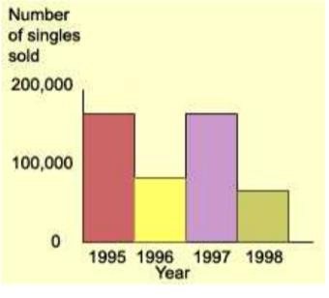
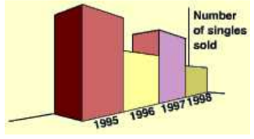
Examples For each of these eight graphs answer the following three questions: (a) What is the main message that the graph is trying to tell you? (b) What is bad or misleading about the graph? (c) How could you improve it?
Notes:
30 sec phone call graph:
Only showing a small part of the vertical axis makes it appear Octas is by far the better option. On closer inspection the difference is not that great. Gives a misleading impression.
Presidential race graph:
- Oversized volumes of objects that are too big for the scale ( Obama vs McCain. Also Clinton vs Huckabee) . They are not the same yet the bars are equal)

Slide 11
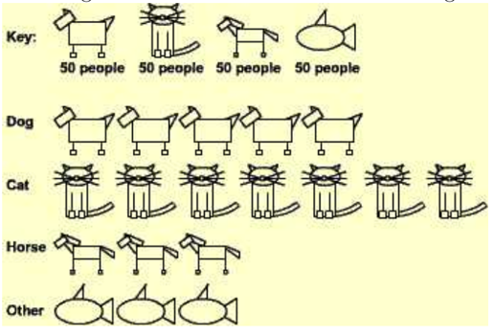
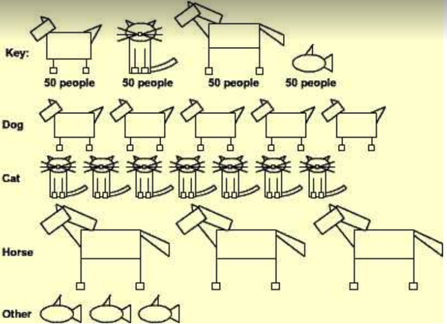
Examples For each of these eight graphs answer the following three questions: (a) What is the main message that the graph is trying to tell you? (b) What is bad or misleading about the graph? (c) How could you improve it?
Notes:
30 sec phone call graph:
Only showing a small part of the vertical axis makes it appear Octas is by far the better option. On closer inspection the difference is not that great. Gives a misleading impression.
Presidential race graph:
- Oversized volumes of objects that are too big for the scale ( Obama vs McCain. Also Clinton vs Huckabee) . They are not the same yet the bars are equal)

Slide 12
Complete Graphs in Contexts worksheet
Complete Misleading Graphs worksheet
- Option to complete these questions using the cooperative learning strategies like “Carousel” or “Gallery Walk”.

